Slide 1

Test Drive an Angular App
Using UI, Integration, and Unit Tests
Matthew Knowles
Software Craftsman at Greater Sum
www.GreaterSum.com
@MatthewYKnowles
Matthew@GreaterSum.com

Slide 2

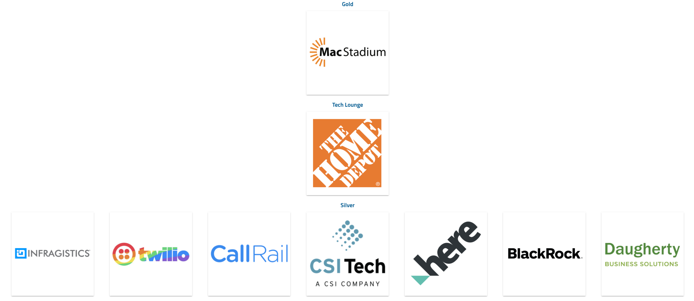

Slide 3
Tests
Notes:
We are going to talk a lot today about specific types of tests but lets first start zoomed out and ask why do we write tests? What reasons do y’all have for writing tests?

Slide 4
Why Write Tests?
Verify functionality
Defend against unexpected change
Executable documentation of the code
Notes:
These are generally the reasons I hear for writing tests.
Executable documentation of code is maybe an outlier here but what I mean by that is if someone asked me what the current project that I am working on does I would immediately look to the UI/E2E testing suite and start reading off test names.
You can login create a support ticket and receive a confirmation email
You can login upload a log file
You can login and download the latest version of the software

Slide 5
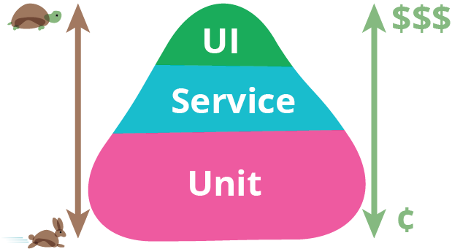
Test Automation Pyramid
https://martinfowler.com/bliki/TestPyramid.html
Notes:
Today I am going to focus on three separate types of tests: UI (E2E), Integration (Service), and Unit Tests. The picture you see is pretty common and represents the test automation pyramid. It describes the composition of tests that you would like to have make up your automated testing suite. We will get more into what these different tests mean in a little bit but the important takeaway is that UI tests are extremely slow and expensive while unit tests are very quick and cheap. Money is a representation of time to write and maintain the tests. For example UI tests generally touch a lot of different components throughout their execution so they are the most likely to need to be updated as your app changes.

Slide 6
Behavior Driven Development (BDD)
Notes:
OK we established that we would write a lot of unit tests and as few UI tests as possible in our automated testing suite, but where do we start? What test do we write first? BDD is a methodology that at a basic level encourages representatives of Dev, Test, and Product to break down user stories into examples or “scenarios” of a what a user would be able to do once the user story is completed
If we were building the Connect Tech 2020 website a user story might be
As a potential speaker I can submit a talk online
The scenarios for that specific story might be
I navigate to the talk submission page, enter my name, email, title, abstract and submit my potential talk
If I try and submit before June 1 I get a warning saying that the call for proposals is not open yet
Following BDD the first test you write is a failing acceptance/scenario test which looking back on the pyramid would be a slow expensive test. This test is generally a UI/E2E test

Slide 7
UI Tests
Exercise your code in a live or live like environment
Verify that all components are connected correctly
Human Readable (product owner readable)
Satisfy Acceptance Criteria
Living Documentation
Environment is configured correctly

Slide 8
User Story
We are creating a website for Connect.Tech 2020 and we would like a way for potential speakers to submit their proposals.
Notes:
This is what the product side wants

Slide 9
1st Acceptance Test – Pseudo Code
Navigate to talk submission page
Fill in name
Fill in email
Fill in submission title
Submit talk
See submission was successful message

Slide 10
Protractor – built on Selenium with knowledge of Angular Components. Waits for async requests to resolve.

Slide 11
Data Attribute
data-test=‘intent-of-object’
data-testid=‘intent-of-object’
data-whatever
Notes:
Finding HTML elements in UI tests or Angular component tests can be tricky.
Some strategies include finding element by text or by giving element an id to find
I have found the most success with giving elements I want to test a data attribute that signifies that its being used by a test and give it a name in kebob case of why I would want to grab it.
You can use data- anything

Slide 12
Lets Create Our App and Write Our First Test
Tools I will be using
WebStorm from JetBrains
Angular CLI
NodeJS for package management

Slide 13
Live Coding: Write Failing UI/E2E Test

Slide 14
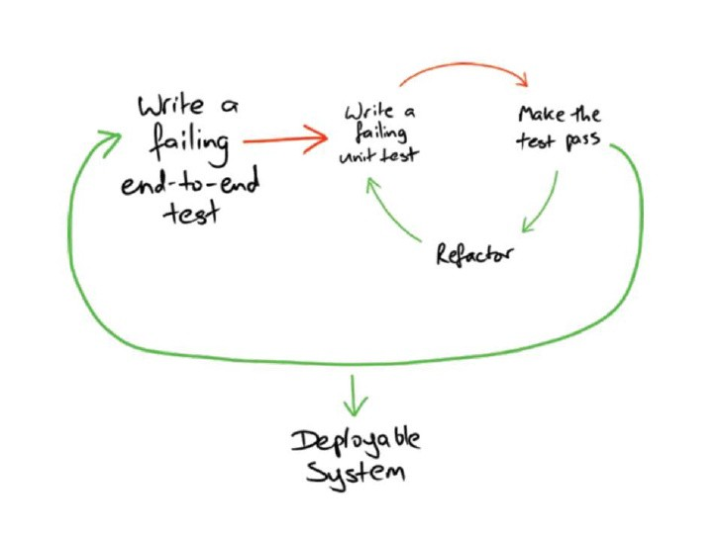
Double Loop TDD
https://medium.com/asos-techblog/atdd-acceptance-test-driven-development-at-asos-81577568e4f2
Notes:
The idea with double loop TDD or Acceptance Test Driven development is that we leave the Acceptance or UI test failing for awhile and do small Test Driven Development on smaller bits of logic to drive the code to pass the UI test

Slide 15
What is Test Driven Development (TDD) ?
Notes:
What do you understand about TDD? Has anyone used it?

Slide 16
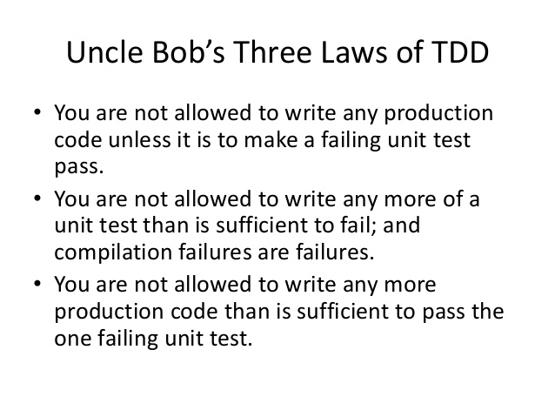
Notes:
These are Robert Martin’s (one of the main advocates for TDD) three laws of TDD. These laws create a cadence for first writing a small test, writing just enough code to pass that test and then writing the next failing test

Slide 17
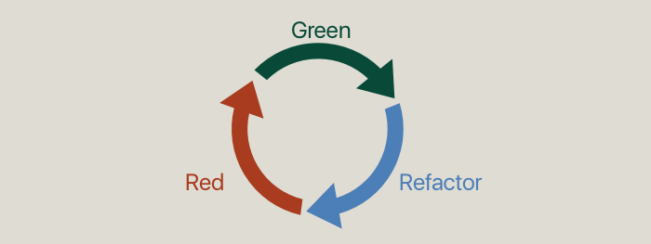
TDD Cycle
Notes:
Mike Clement is giving a talk tomorrow on TDD and the TDD Cycle

Slide 18
Components to test drive
Routing to talk submission page
Form for entering name, email, and title
Validation on submit button
Making the call to the API
Displaying the information from the API
Notes:
Testing integration of my code with framework. I would like to make sure that when I fill in all the form values on my component that I can correctly gather them up and create a submissions object and send it to my backend.

Slide 19
Live Coding: Test Drive Components/Units

Slide 20
Starting with a failing Acceptance Test focuses your code on value
Notes:
Start with a failing UI/E2E test
Test drive each logical component of functionality
When we think we have delivered on the acceptance criteria move on to the next acceptance criteria
If that’s all the acceptance criteria for that user story then you are done with the story
Starting with the failing UI test keeps you focused on what delivers value to the customer and hopefully discourages gold plating

Slide 21


Slide 22
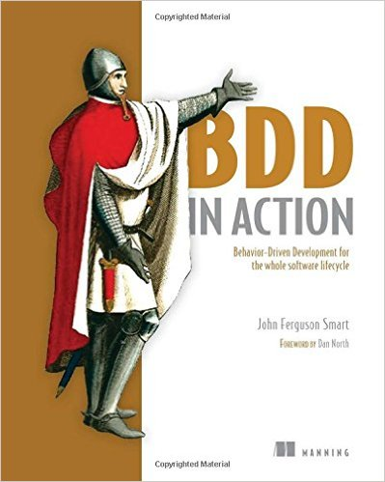



Slide 23
Questions?
@MatthewYKnowles
Matthew@GreaterSum.com

